Slide 1

Design Patterns
A path to Clean Code.
By Ashish Dhyani

Slide 2
Design Patterns
Agenda
Why we need it
How I come across delivering this session

Slide 3
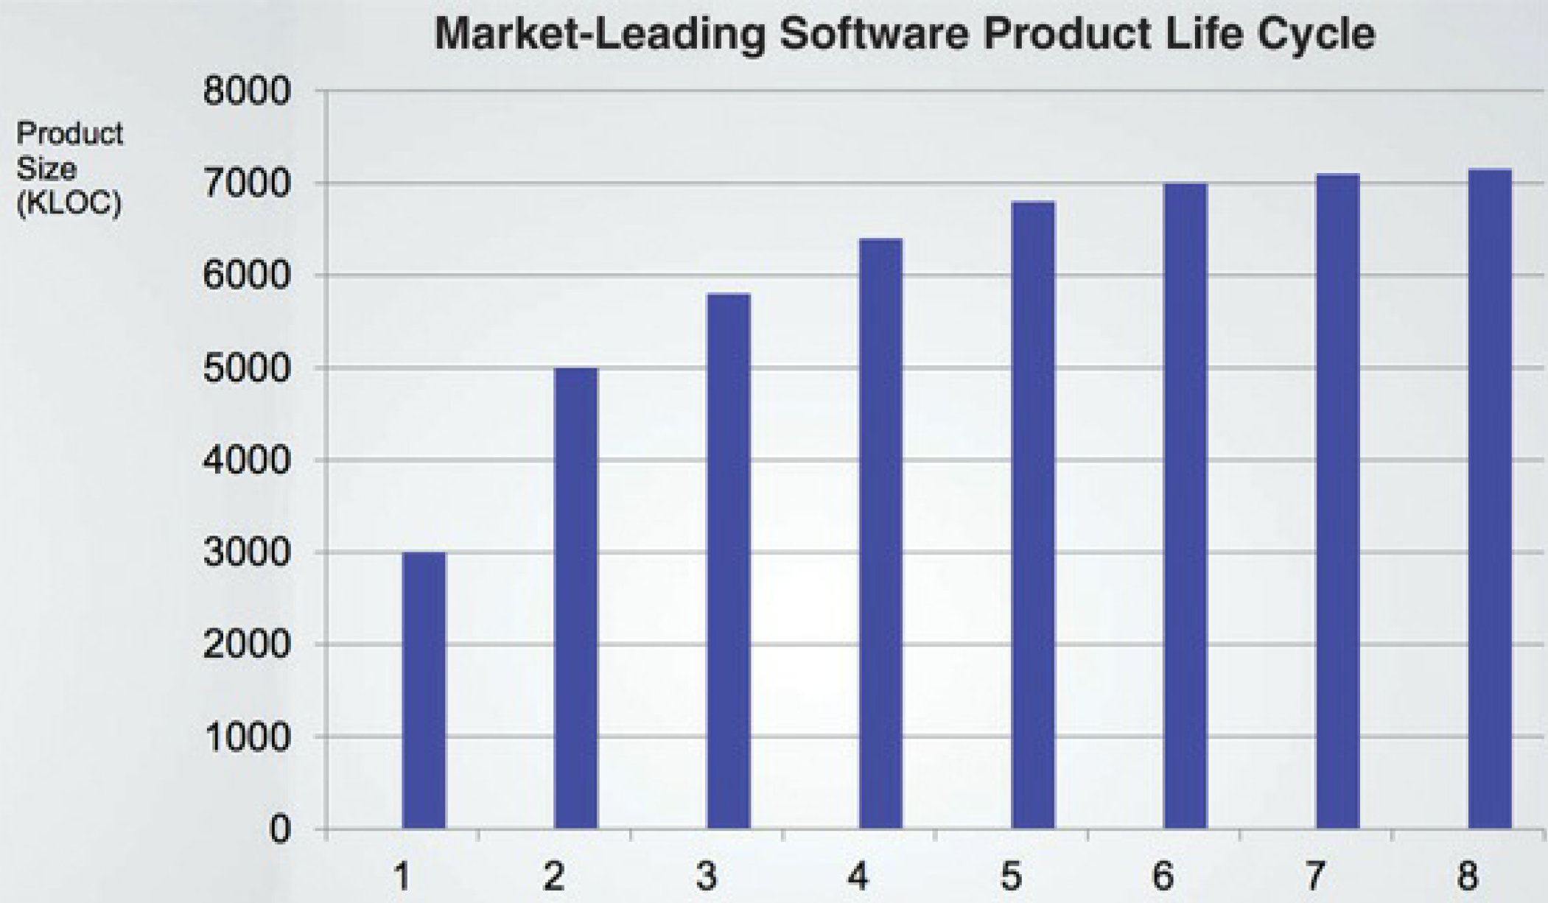

Slide 4
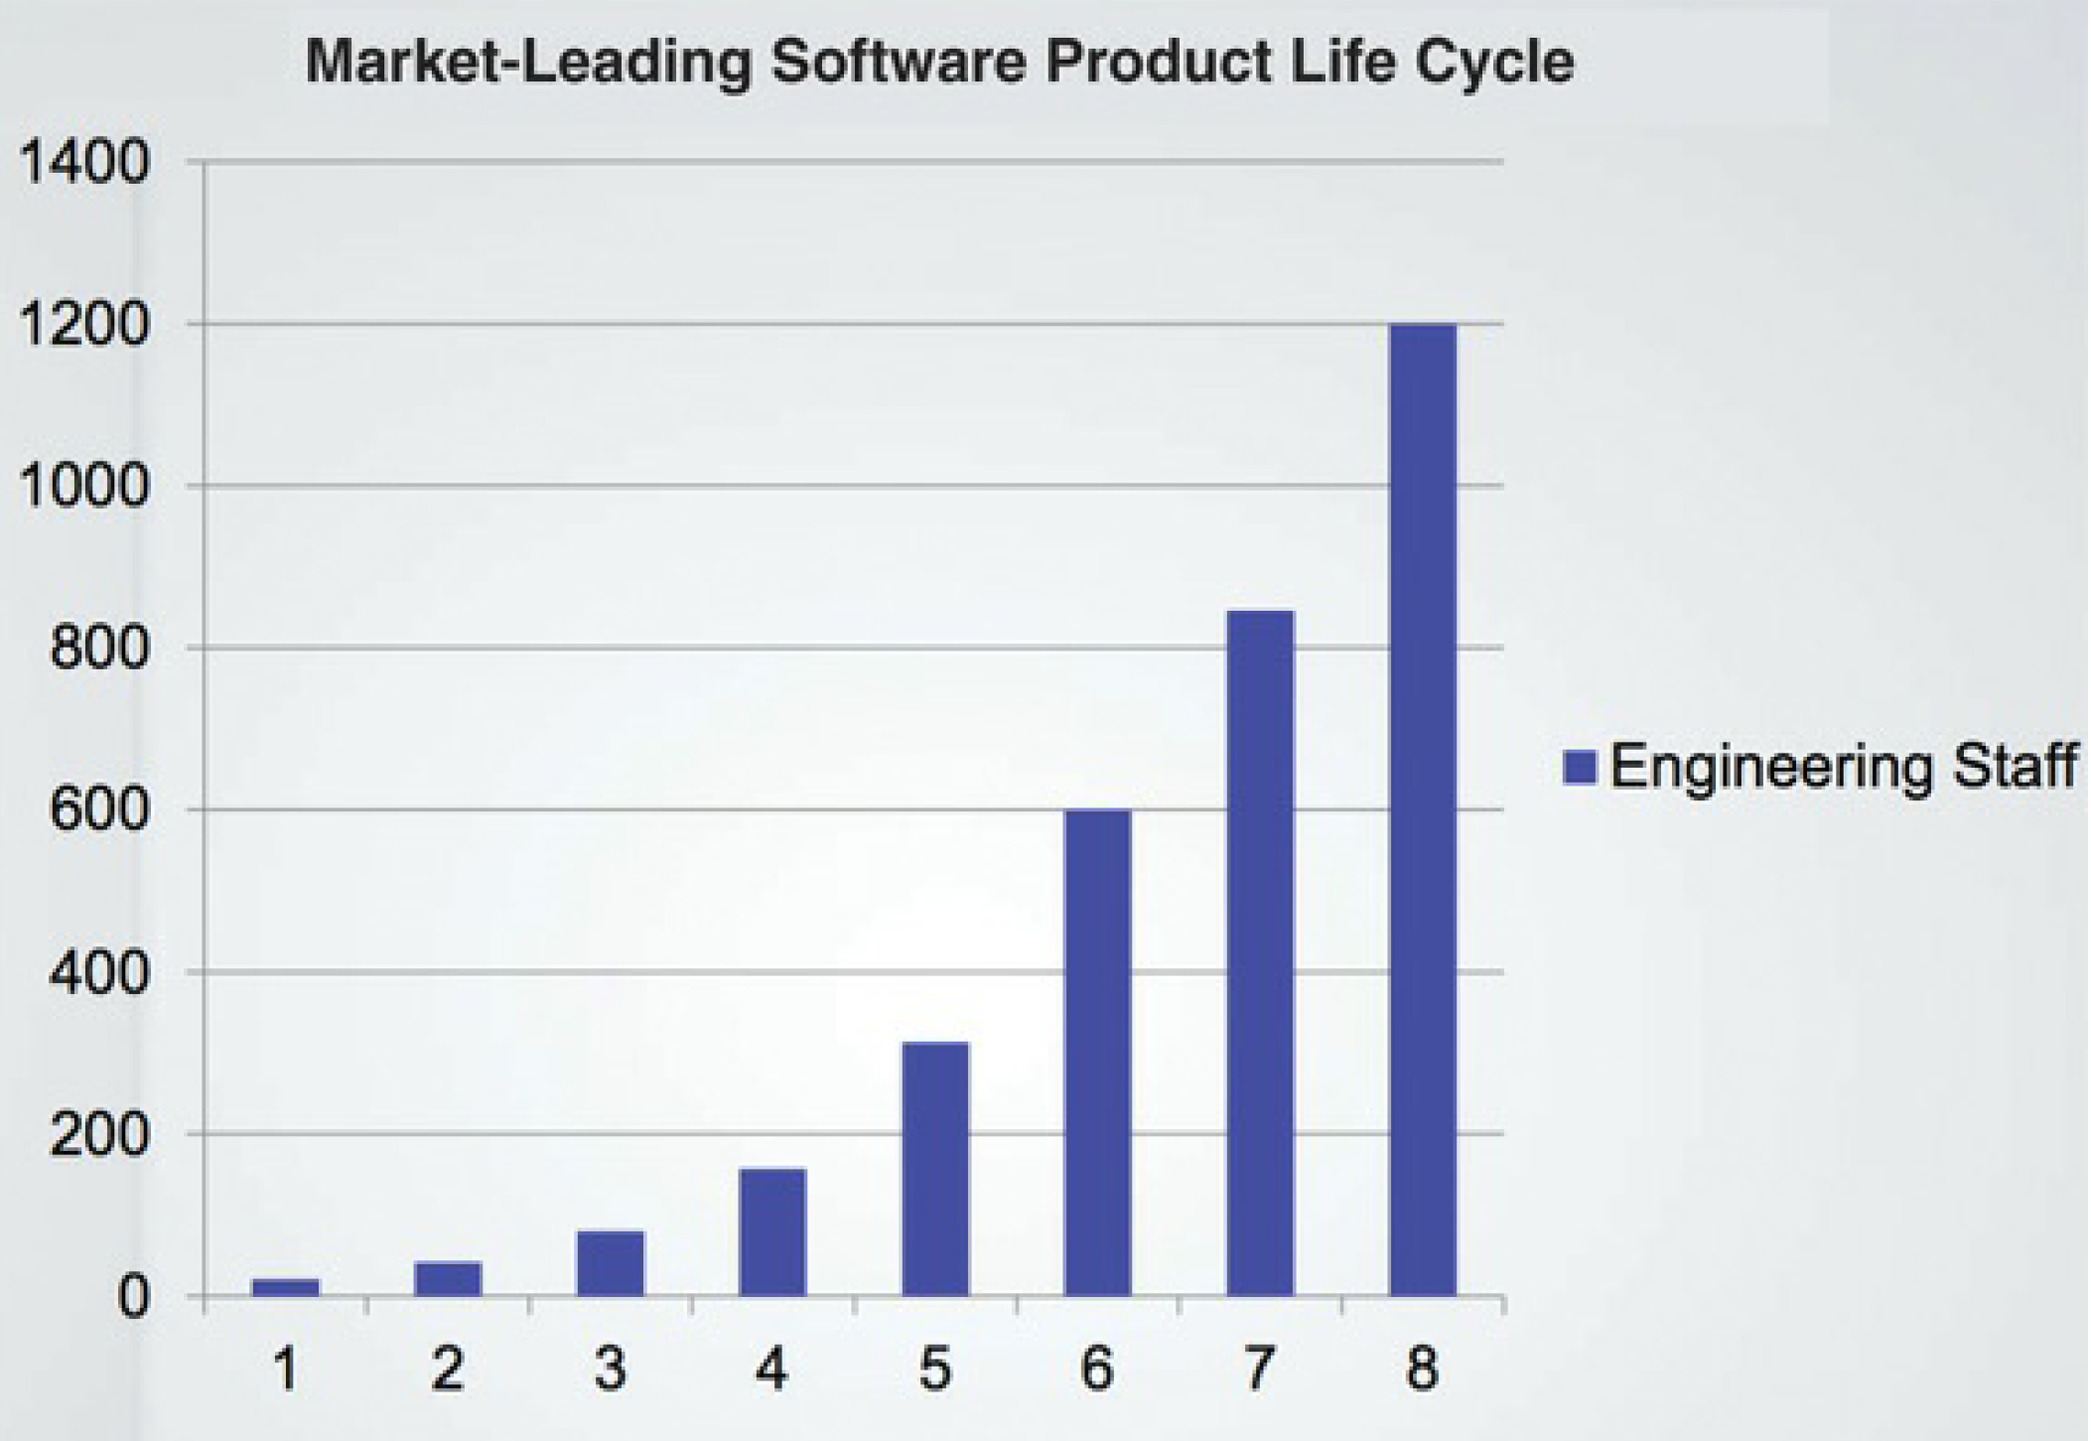

Slide 5
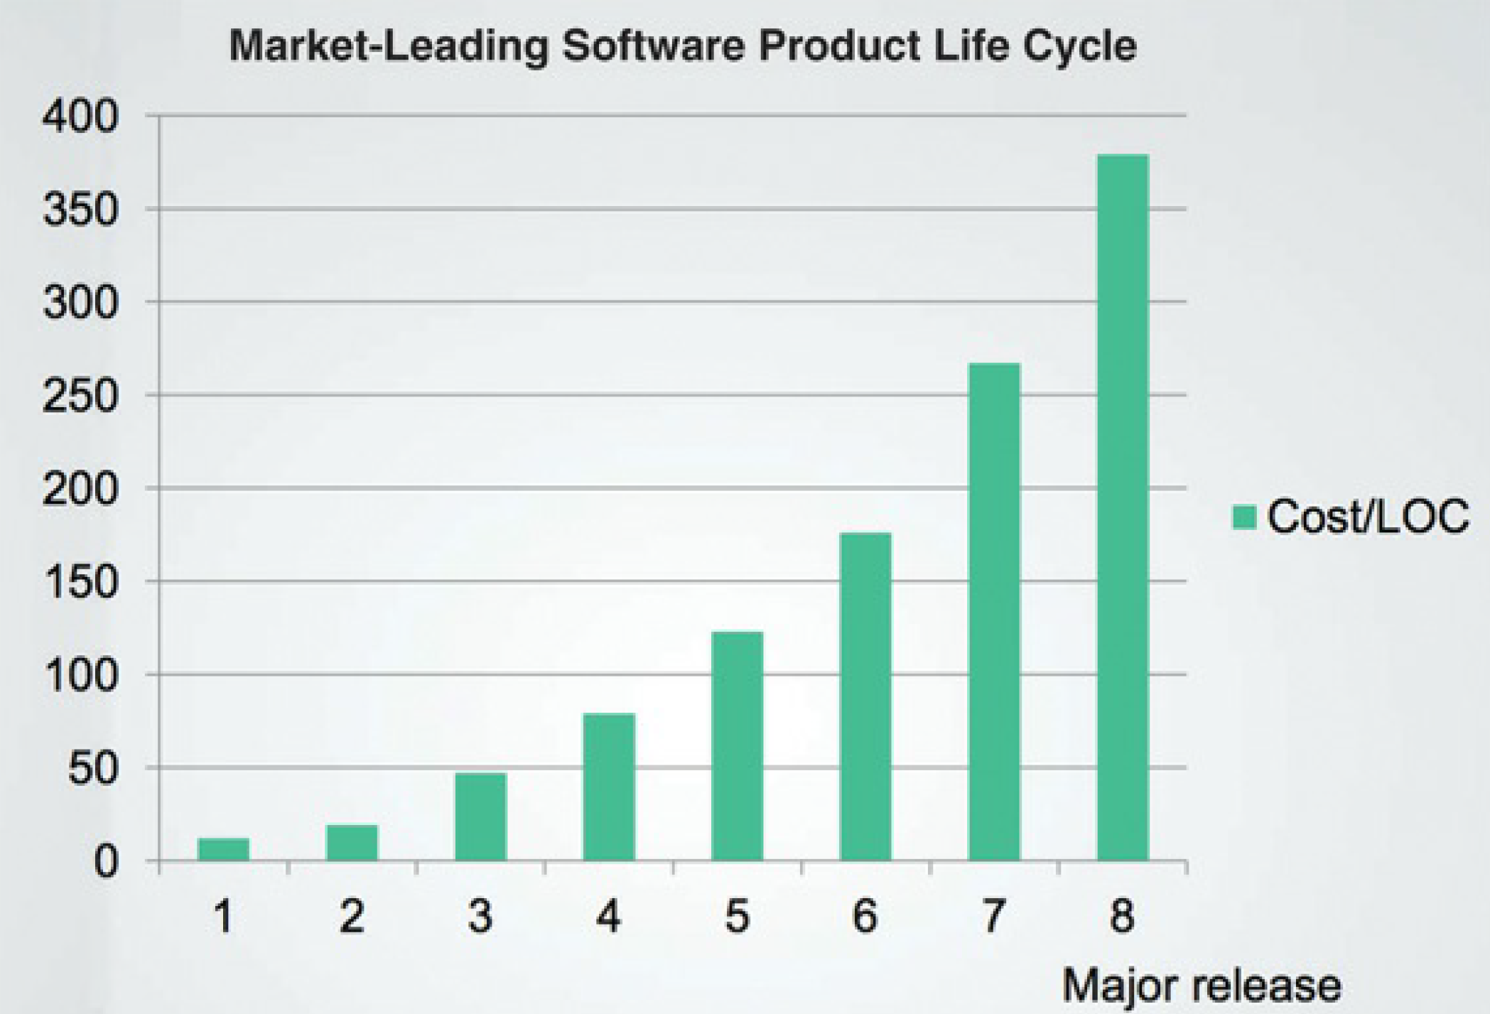

Slide 6
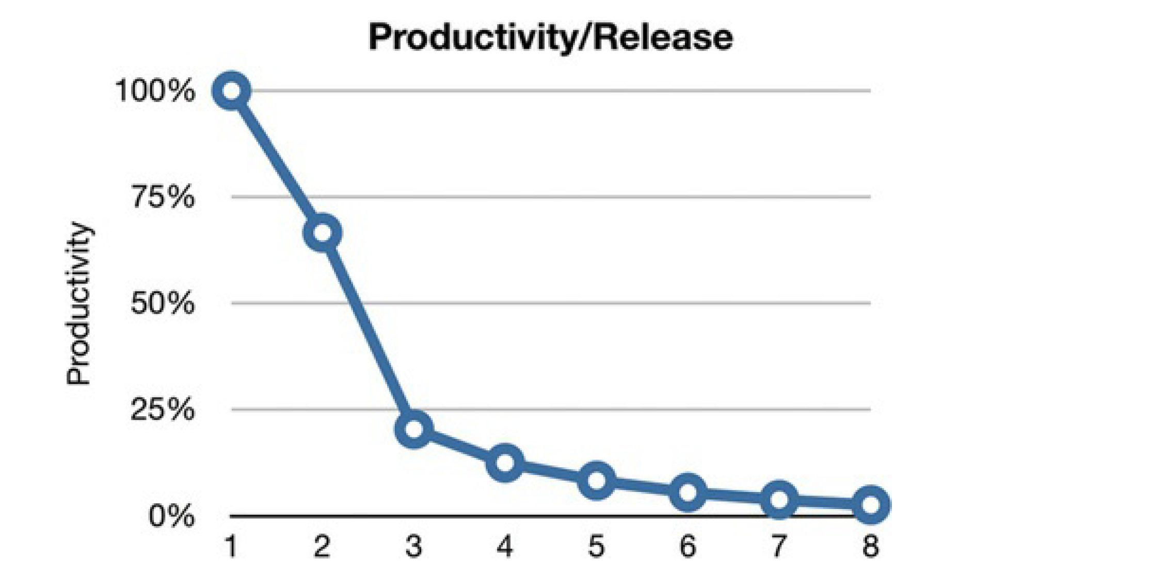

Slide 7

What is the problem?

Slide 8

Dirty Code
Tight coupling.
Bad naming conventions and commenting.
Non optimized handling of objects creations and relationships.
When something changes, need to change at lot of places.
Performance issues.

Slide 9

Clean code
It is a method to write your application in such a way that is least affected due to change

Slide 10
What are the Design Patterns ?

Slide 11

Design Patterns
In software development, a patterns (or design pattern) is a written document that describes a general solution to a design problem that recurs repeatedly in many projects. Software designers adapt the pattern solution to their specific project.

Slide 12
Design Patterns
Creational
Structural
Behavioral

Slide 13
Creational Patterns
Singleton
Factory
Abstract Factory
Builder
Protype
Creation patterns are ones that create objects, rather than having to instantiate objects directly. This gives the program more flexibility in deciding which objects need to be created for a given case.

Slide 14
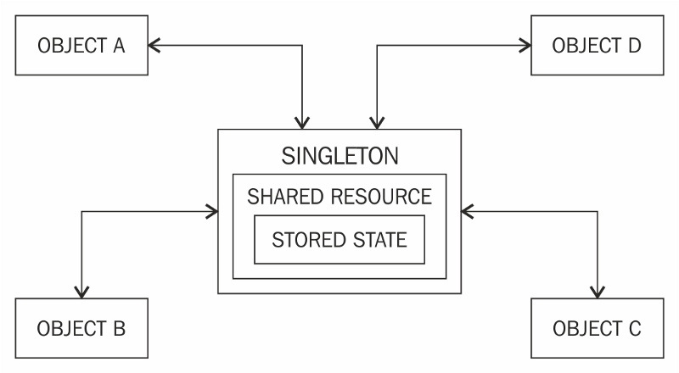
Singleton
Restricts object creation for a class to only one instance.

Slide 15
Singleton VS Static
Singleton = Static + Thread safety + Lazy loading + Capability to pass object as reference

Slide 16
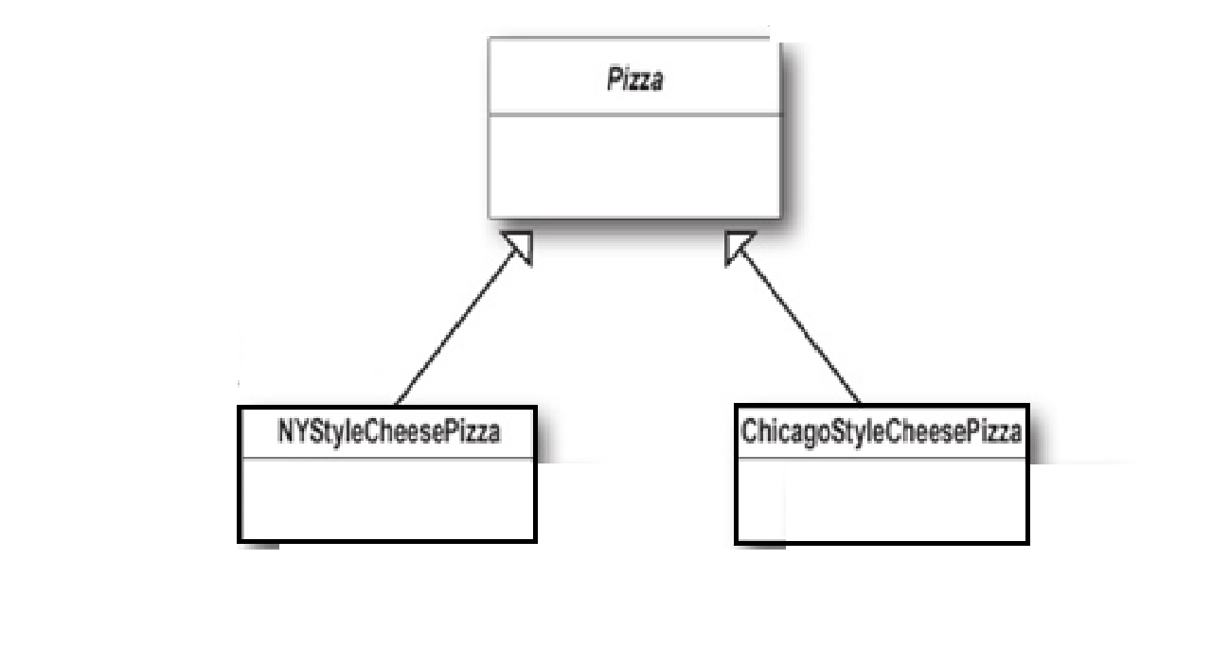
Factory
Factory methods deal with the problem of creating objects without having to specify the exact class of the object that will be created.

Slide 17
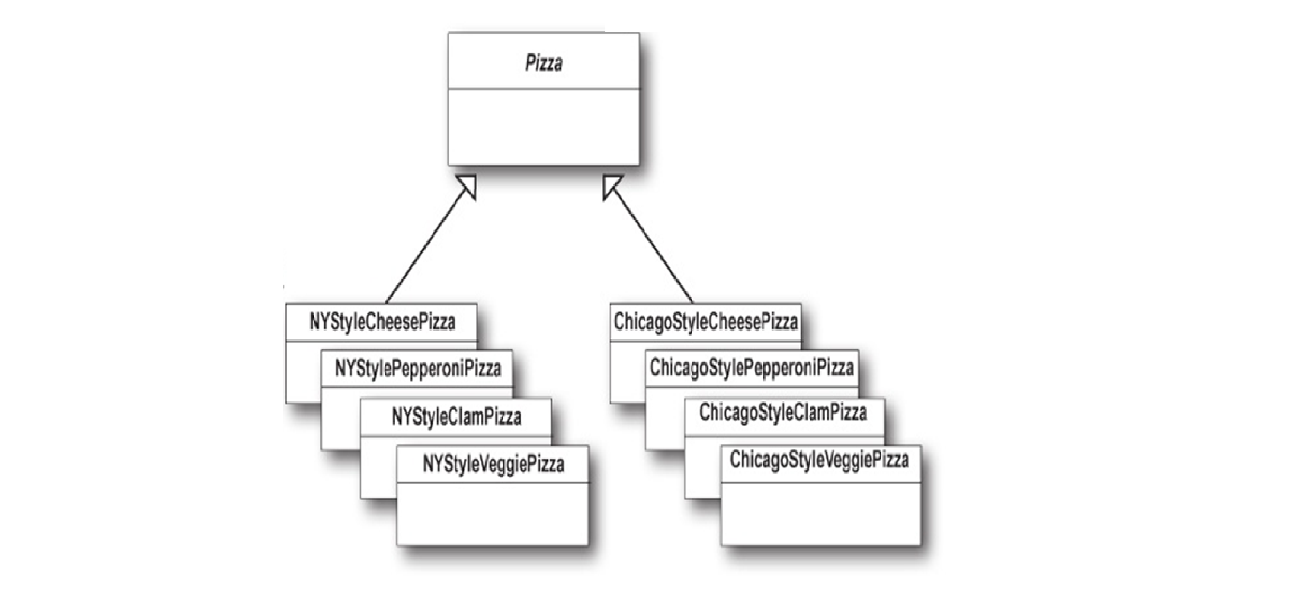
Abstract Factory
The abstract factory pattern provides a way to encapsulate a group of individual factories that have a common theme without specifying their concrete classes

Slide 18
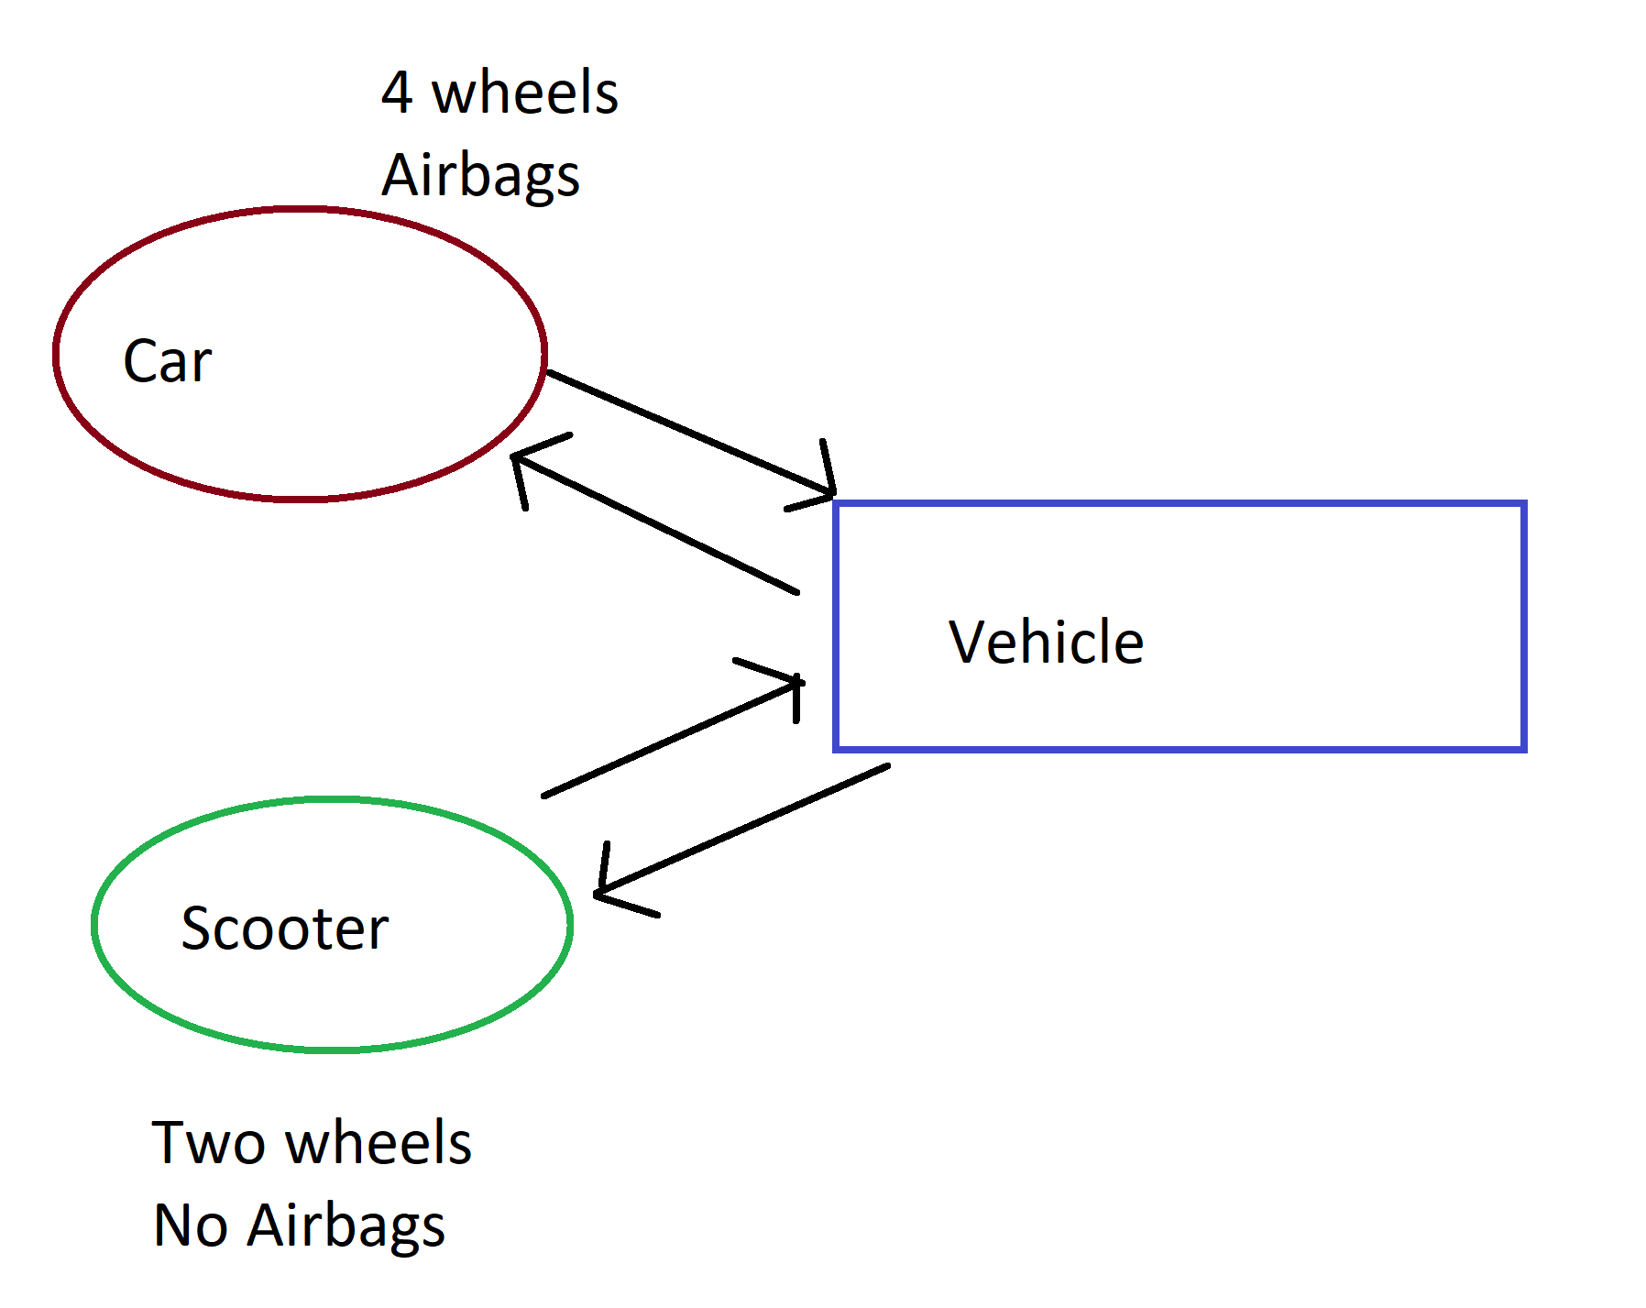
Builder
Constructs complex objects by separating construction and representation.
It provides clear separation between the construction and representation of an object.
It provides better control over construction process.
It supports to change the internal representation of objects.

Slide 19
Prototype
Creates objects by cloning an existing object.

Slide 20
Structural Patterns
Adapter
Bridge
Composite
Decorator
Façade
Flyweight
Structural patterns are concerned with how classes and objects are composed to form larger structures.

Slide 21
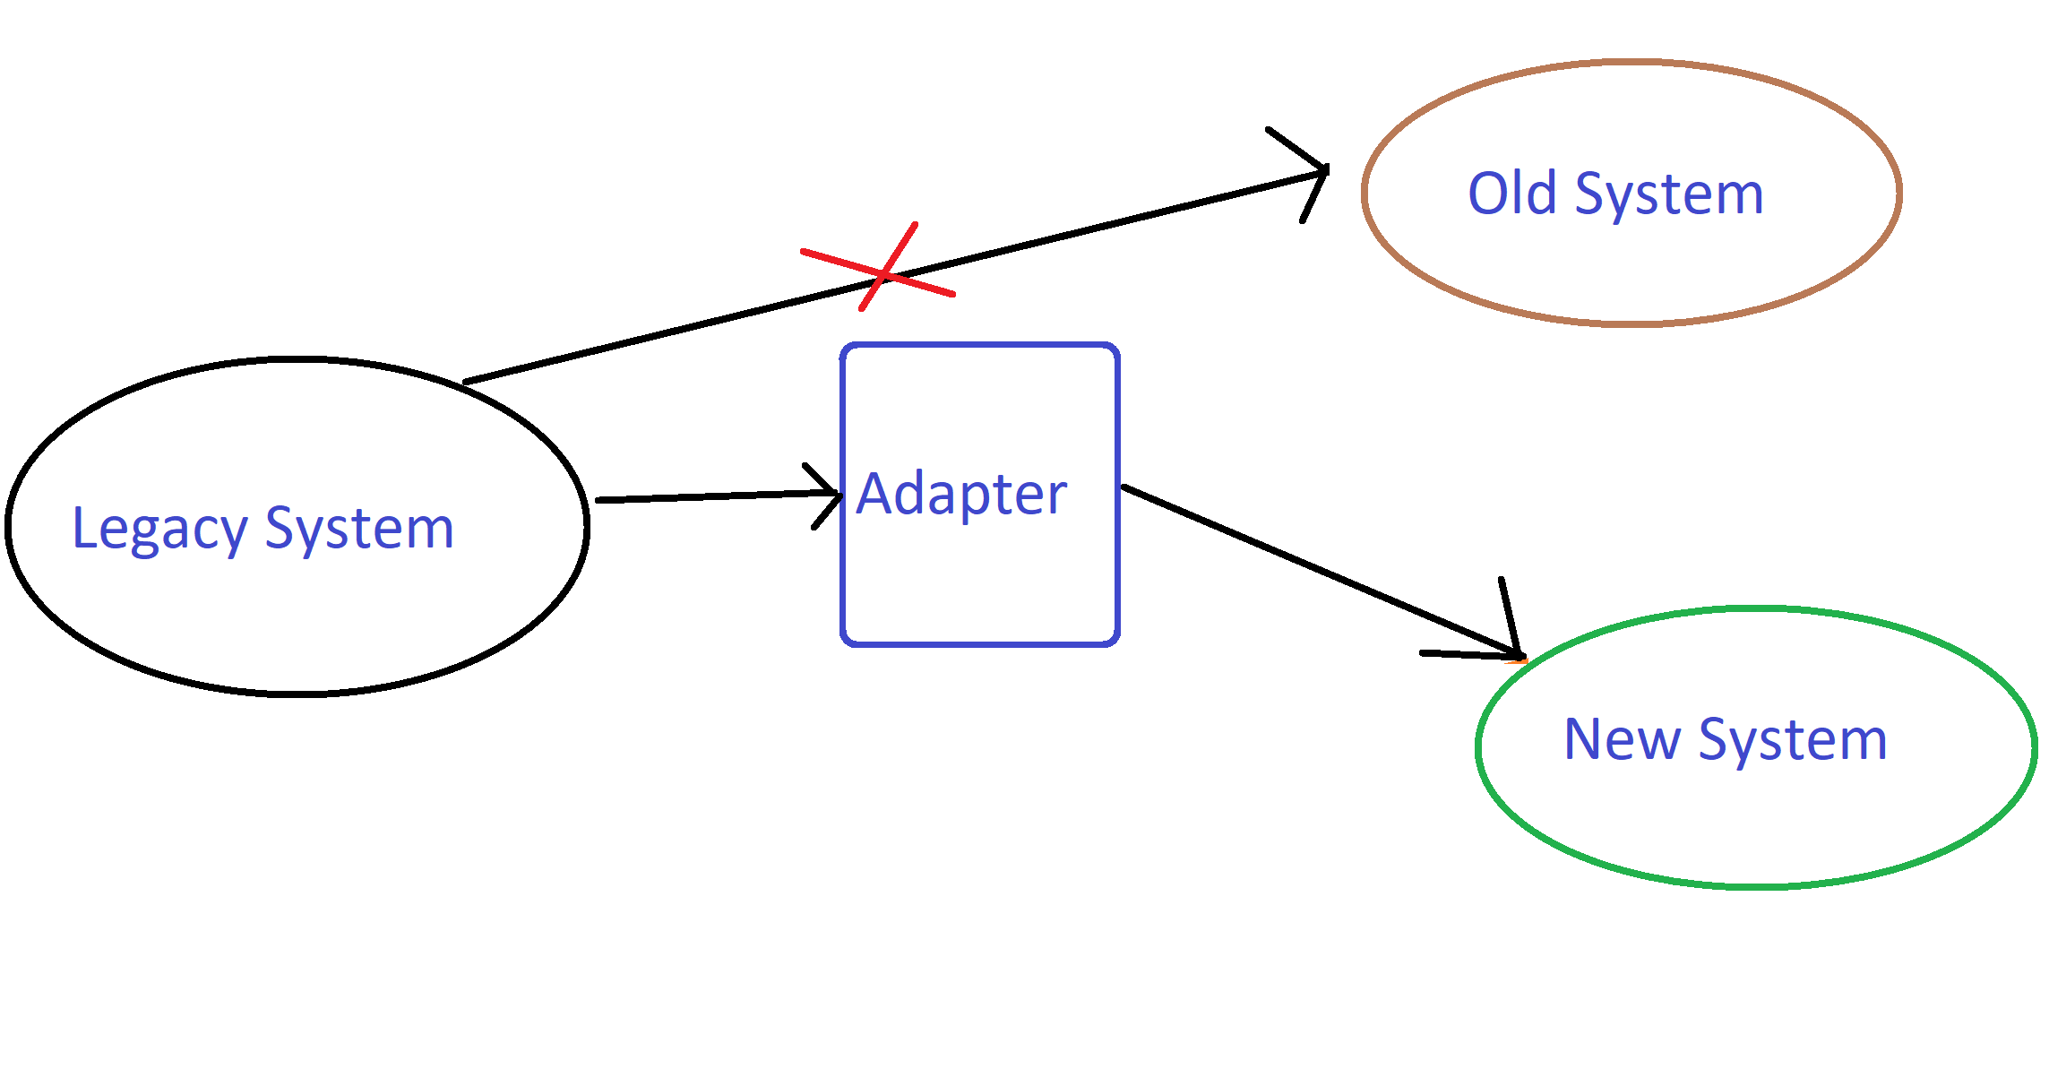
Adapter
Makes two incompatible system work together
It allows reusability of existing functionality.
Makes testing easier

Slide 22
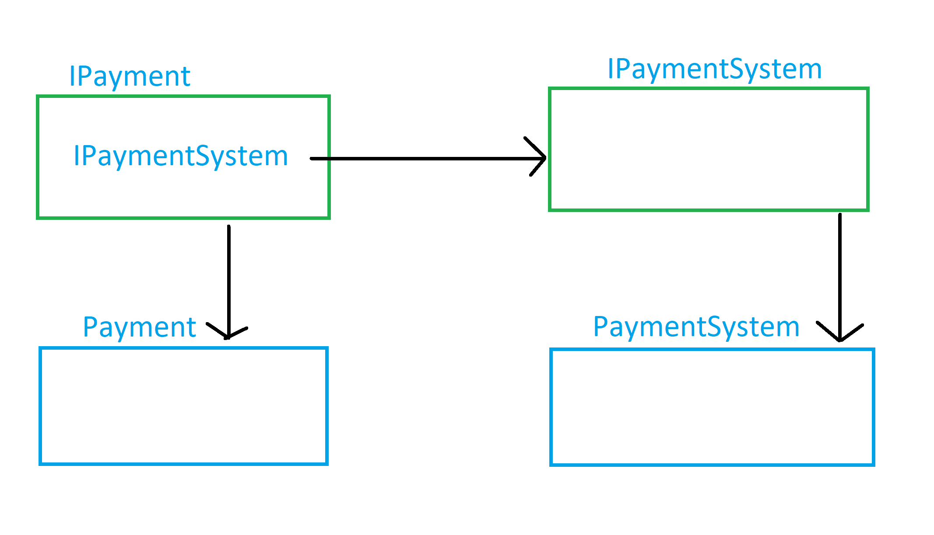
Bridge
Decouple an abstraction from its implementation so that the two can vary independently

Slide 23
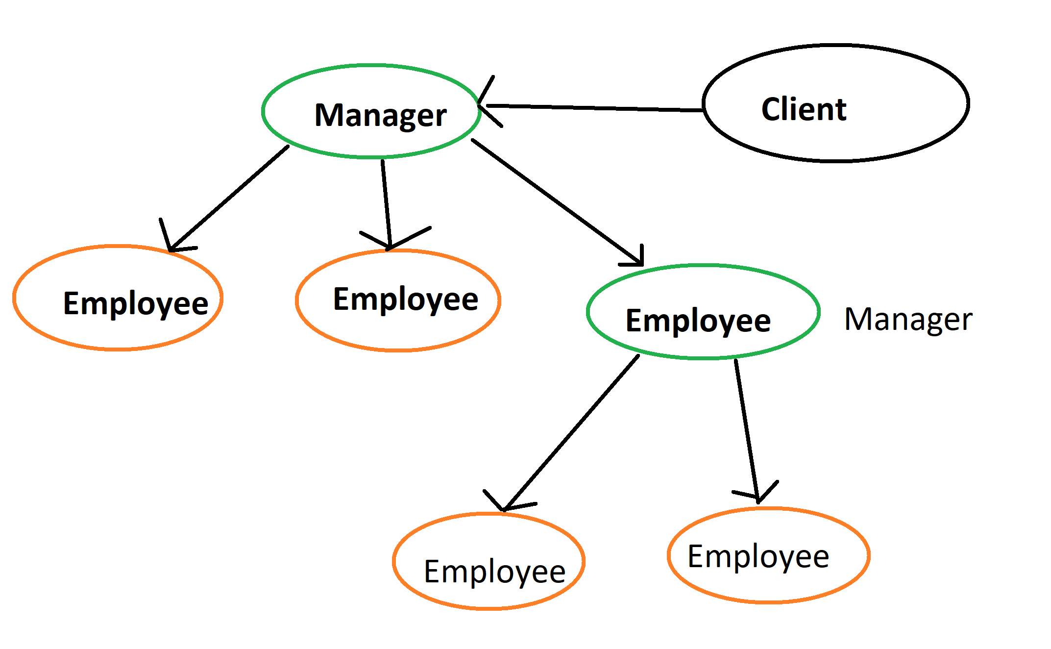
Composite
A part-whole hierarchy should be represented so that clients can treat part and whole objects uniformly.
A part-whole hierarchy should be represented as tree structure.

Slide 24
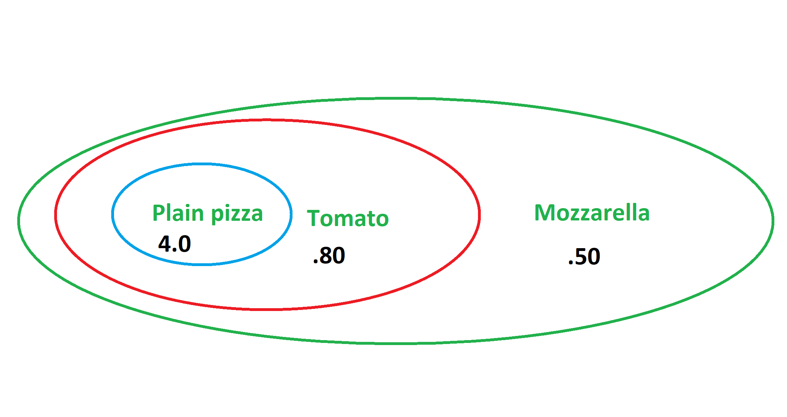
Decorator
Decorator pattern allows a user to add new functionality to an existing object without altering its structure
You don’t have to create many classes.

Slide 25
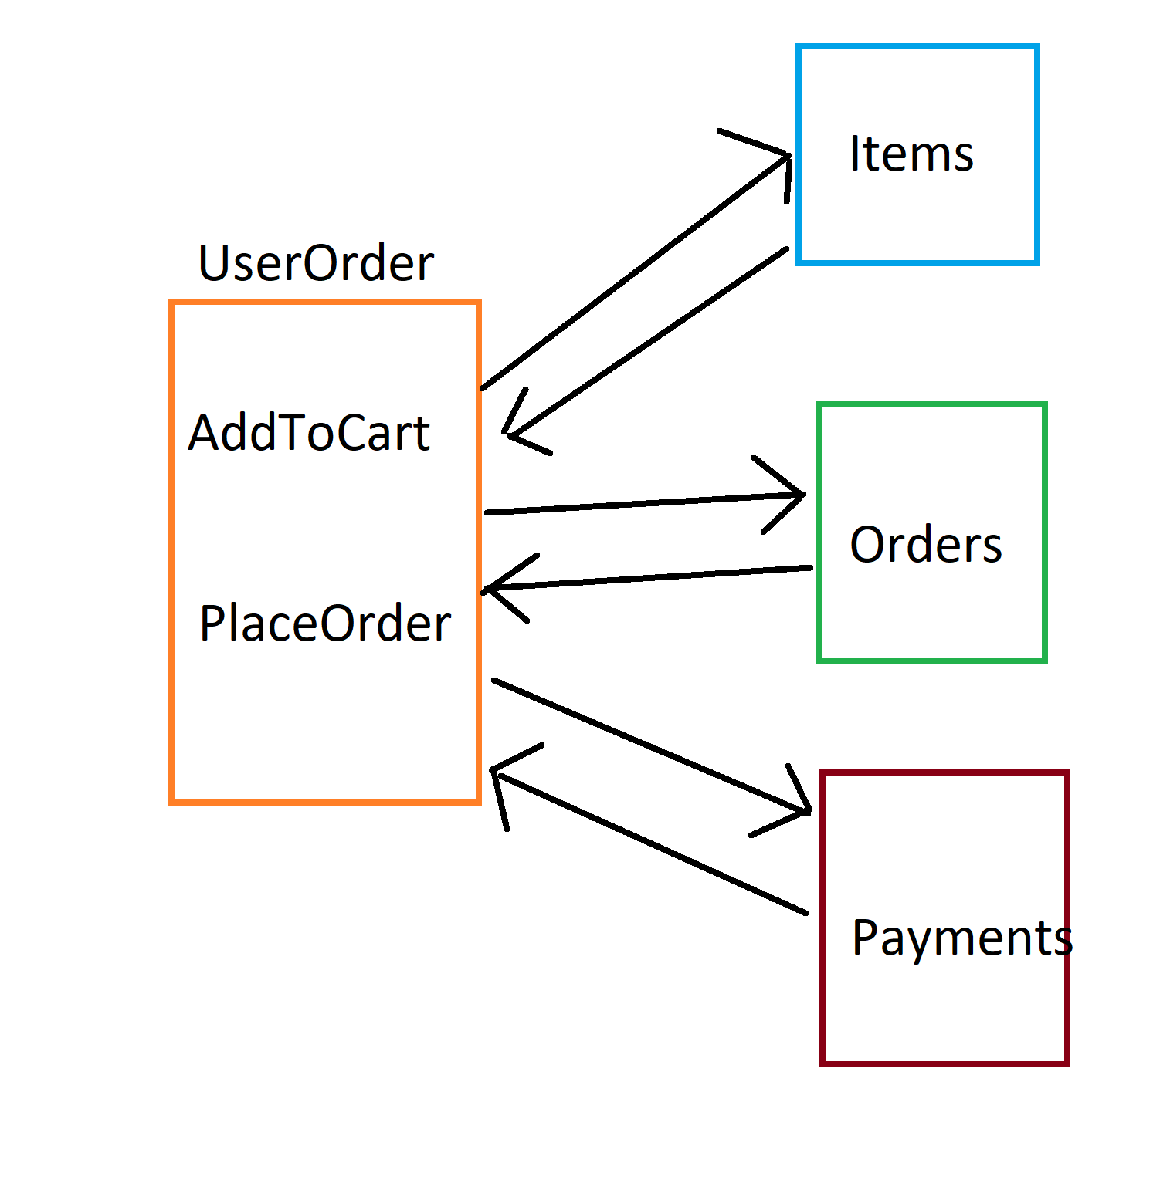
Facade
Make complex system simpler

Slide 26
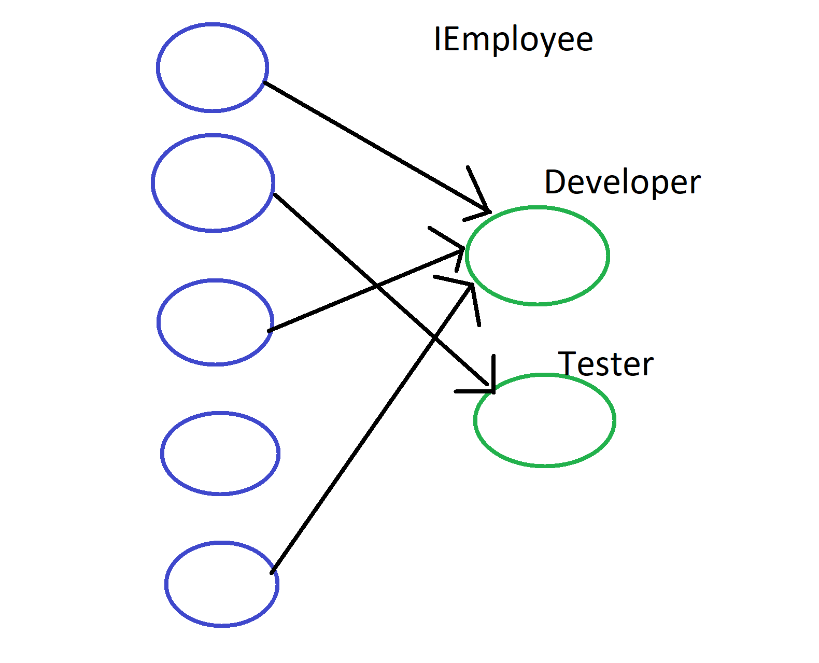
Flyweight
dealing with large numbers of objects with simple repeated elements that would use a large amount of memory if individually stored.

Slide 27
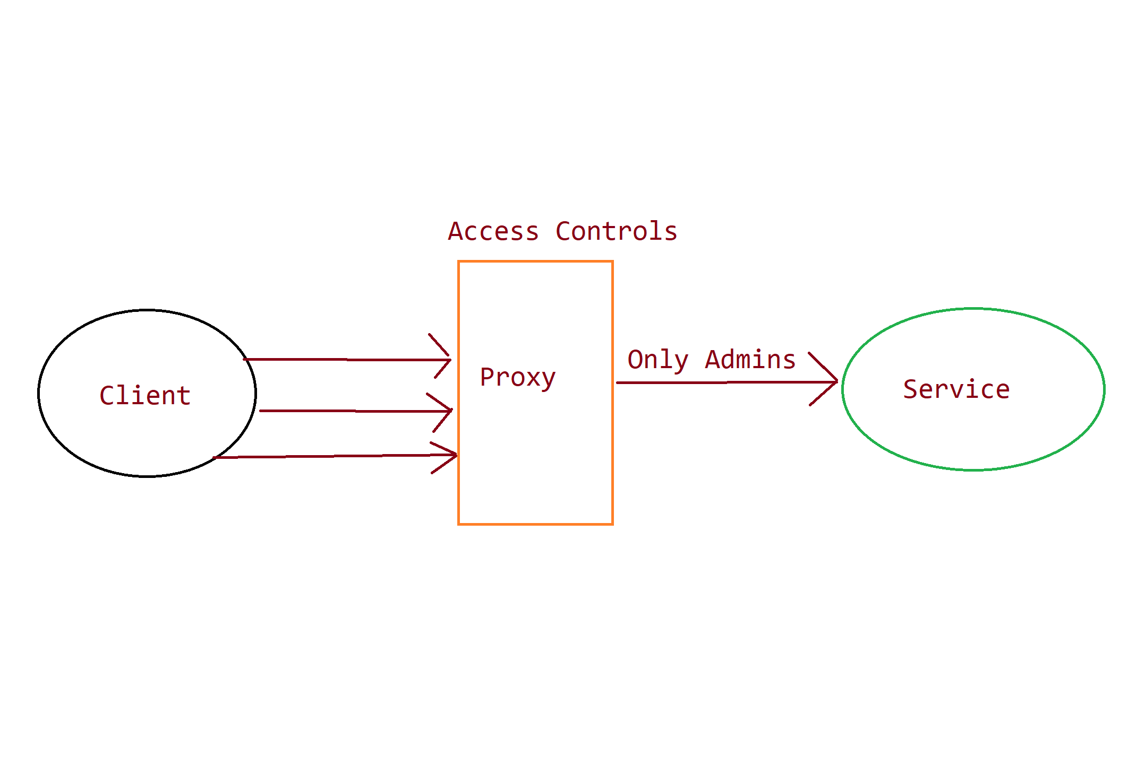
Proxy
Controls and manage access to the object they are protecting

Slide 28
Behavioral Patterns
Chain of responsibility
Command
Observer
Strategy
Template Method
Visitor
Behavior patterns are concerned with algorithms and the assignment of responsibilities between objects.

Slide 29
Chain of responsibility
Behavior patterns are concerted with algorithms and the assignment of responsibilities between objects.

